Slide 1
STA623 Bayesian Data Analysis
Session 5: Markov Chain Monte Carlo (cont’d) Marc Henrion

Slide 2

Preliminaries
These notes were written in quarto.
All examples / code in these notes is R and NIMBLE / BUGS for Bayesian model specification.
GitHub repository - will contain all course materials by the end of the week.
https://github.com/gitMarcH/UNIMA_STA623_2025

Slide 3
Preliminaries
Some references for Bayesian statistics / data analysis are:
Hoff, P.D. (2009). “A First Course in Bayesian Statistical Methods.” Springer.
Gelman, A., Carlin, J.B., Stern, H.S., Dunson, D.B., Vehtari, A., Rubin, D.B. (2014). “Bayesian Data Analysis”. 3rd ed. CRC Press.
Ramoni, M., Sebastiani, P. (2007), ‘Bayesian Methods’, in Berthold, M., Hand, D.J. (eds.). “Intelligent Data Analysis”, 2nd ed., Springer, pp.131-168
Stone, J.V. (2013). “Bayes’ Rule: A Tutorial Introduction to Bayesian Analysis”. Sebtel Press.

Slide 4
Notation
$X,Y,Z$ - random variables
$x,y,z$ - measured / observed values
$\overset{‾}{X}$, $\overset{‾}{Y},\overset{‾}{Z}$ - sample mean estimators for X, Y, Z
$\overset{‾}{x}$, $\overset{‾}{y},\overset{‾}{z}$ - sample mean estimates of X, Y, Z
$\hat{T}$, $\hat{t}$ - given a statistic T, estimator and estimate of T
$P\left(A\right)$ - probability of an event A occurring
$f_{X}\left(.\right)$, $f_{Y}\left(.\right),f_{Z}\left(.\right)$ - probability mass / density functions of X, Y, Z; sometimes $p_{X}\left(.\right)$ etc. rather than $f_{X}\left(.\right)$
p(.) - used as a shorthand notation for pmfs / pdfs if the use of this is unambiguous (i.e. it is clear which is the random variable)
$X∼F$ - X distributed according to distribution function F
$E\left[X\right]$, $E\left[Y\right]$, $E\left[Z\right]$, $E\left[T\right]$ - the expectation of X, Y, Z, T respectively

Slide 5
MARKOV CHAIN MONTE CARLO (cont’d)

Slide 6
MCMC: NIMBLE
NIMBLE is an R package to implement Bayesian models using MCMC for parameter estimation. NIMBLE stands for Numerical Inference for statistical Models for Bayesian and Likelihood Estimation.
NIMBLE was developed by a team based at University of California, Berkeley and has now a maintainer team spanning several institutions. NIMBLE is based on the Bayesian inference using Gibbs sampling (BUGS) Bayesian computation environment developed by the MRC Biostatistics Unit at Cambridge University and uses largely the same syntax.

Slide 7
MCMC: NIMBLE
NIMBLE provides, however, more functionality than BUGS, in particular providing access to more modern MCMC samplers, such as Hamiltonian Monte Carlo (often through additional R packages such as nimbleHMC). NIMBLE also aims to make it easy for users to extend the functionality of BUGS themselves, by adding their own samplers, distributions, …
NIMBLE provides the MCMC framework, but other packages are useful for processing the output from NIMBLE. Chief among these are the coda and MCMCvis packages.
NIMBLE is installed and loaded just like any other R package: install.packages("nimble") and library(nimble) - no separate downloads and installations required.

Slide 8
MCMC: NIMBLE - alternatives
To note that there are other packages that allow you to implement Bayesian models in R. All of these require you to install the MCMC sampler as a software library separate from R, then install R packages to interface with the sampler. All of these have the advantage that they are not dependent on R, whereas NIMBLE, at least currently, is specific to R.
Given R’s near universal adoption in the statistical research world, this is however not much of a concern.

Slide 9
MCMC: NIMBLE - alternatives
OpenBUGS, interfaced in R using the package R2OpenBUGS; this is an implementation of BUGS.
JAGS, interfaced in R using the package rjags; this is similar to BUGS but tries to figure out the best sampler (e.g. Gibbs, Metropolis-Hastings, Slicer, …) and its parameters for you. JAGS is great, but is maintained by only one and now retired researcher – updates are only very occasional and there is a risk that this MCMC package will not be supported in the future. This course used to be taught using JAGS in the past.
Stan, interfaced in R using the package RStan; the main advantage of Stan used to be that it was the only way to run Hamiltonian Monte Carlo. With the advent of NIMBLE, this has now changed. Specifying models in Stan is somewhat less intuitive than in BUGS-based libraries. Note that there are some packages, e.g. brms, that use Stan under the hood - you specify the model you want to fit in a more traditional fashion and the package writes and run the Stan model for you.

Slide 10
MCMC: NIMBLE - resources
NIMBLE is well documented with the primary source for documentation and tutorials being the NIMBLE website:
https://r-nimble.org/
Specifically, this website has the following resources:
A comprehensive tutorial: https://r-nimble.org/manual/cha-welcome-nimble.html
A cheatsheet for quick reference: https://r-nimble.org/NimbleCheatSheet.pdf
Many additional training materials are hosted on GitHub: https://github.com/nimble-training.

Slide 11
MCMC: NIMBLE code
Note that NIMBLE coding syntax is very similar to R syntax but with some differences, particularly for specifying distribution functions For example the normal distribution takes the mean and precision not standard deviation as default parameterisation (recall thatbif $τ$ is the precision and $σ$ the standard deviation of a normal distribution, then $τ=1/σ^{2}$).
However, unlike other BUGS-based languages, NIMBLE has made efforts to allow alternative, R-like paramterisations: for example dnorm(0,0.01) and dnorm(0,sd=10) are equivalent.

Slide 12
MCMC: NIMBLE
Fitting a NIMBLE model in R requires 3 things:
Dataset.
NIMBLE model code.
R script to pre-process the data, hold the NIMBLE model code, build and run the model using NIMBLE, process the resulting samples from the posterior density.

Slide 13
MCMC: NIMBLE
Example
Fit the model from Practical 3, Exercise 2 using NIMBLE.
Inspect the trace plot and plot the posterior distribution.
Compute the posterior mean and the quantile-based 95% Bayesian confidence interval.

Slide 14
MCMC: NIMBLE
First we need to specify the model using NIMBLE / BUGS code. In R, load the nimble package and use the function nimbleCode() for this:
library(nimble) modCode<-nimbleCode( { # sampling model for(i in 1:N){ y[i]~dbern(pi) } # prior pi~dbeta(2,3) } )
This specifies the model. Now we need to fit this model using MCMC.

Slide 15
MCMC: NIMBLE
Below is a one-line invokation in NIMBLE MCMC invocation. Please note that that niter - nburnin is the number of posterior samples per chain.
parsPosterior<-nimbleMCMC( code=modCode, # this specifies the model code constants=list(N=25), # this lists all constants data=list(y=c(rep(1,16),rep(0,25-16))), # this lists the data monitors=c("pi"), # this specifies the parameter(s) we want to sample during the MCMC nchains=4, # this specifies how many chains we want to run niter=1100, # this specifies the total number of iterations to run nburnin=100, # this specifies the number of burn-in iterations thin=1, # values larger than 1 discard samples after burn-in (thin=10 will only keep every 10th sample) # these days it is usually recommended NOT to thin WAIC=TRUE, # calculates the WAIC online as sampling progresses; this is useful to compare models samplesAsCodaMCMC=TRUE # specify this to be able to handle the output easily with other MCMC packages )

Slide 16
MCMC: NIMBLE
Apart from the one-line invocation, you can also do a full NIMBLE model and MCMC workflow. This takes more coding, but provides some advantages, including:
Finer control over parameters.
Compiling code for faster runtime.
For the rest, the results will be identical to the one-line invocation.

Slide 17
MCMC: NIMBLE
# create model object mod<-nimbleModel( code=modCode, constants=list(N=25), data=list(y=c(rep(1,16),rep(0,25-16))), ) # set up the MCMC modConf<-configureMCMC( model=mod, monitors=c("pi"), enableWAIC=TRUE ) # default random walk Metropolis sampler # build the MCMC modMCMC<-buildMCMC( conf=modConf ) # compilation (optional - but next step will be faster if you do this first) compMCMCCode<-compileNimble(mod) compMCMCModel<-compileNimble(modMCMC,project=mod) # run the MCMC (10,000 samples with 1,000 burn-in iterations) parsPosterior<-runMCMC( mcmc=compMCMCModel, # specify modMCMC to run the uncompiled model if you skipped the compilation step nchains=4, niter=1100, nburnin=100, WAIC=TRUE, samplesAsCodaMCMC=TRUE )

Slide 18
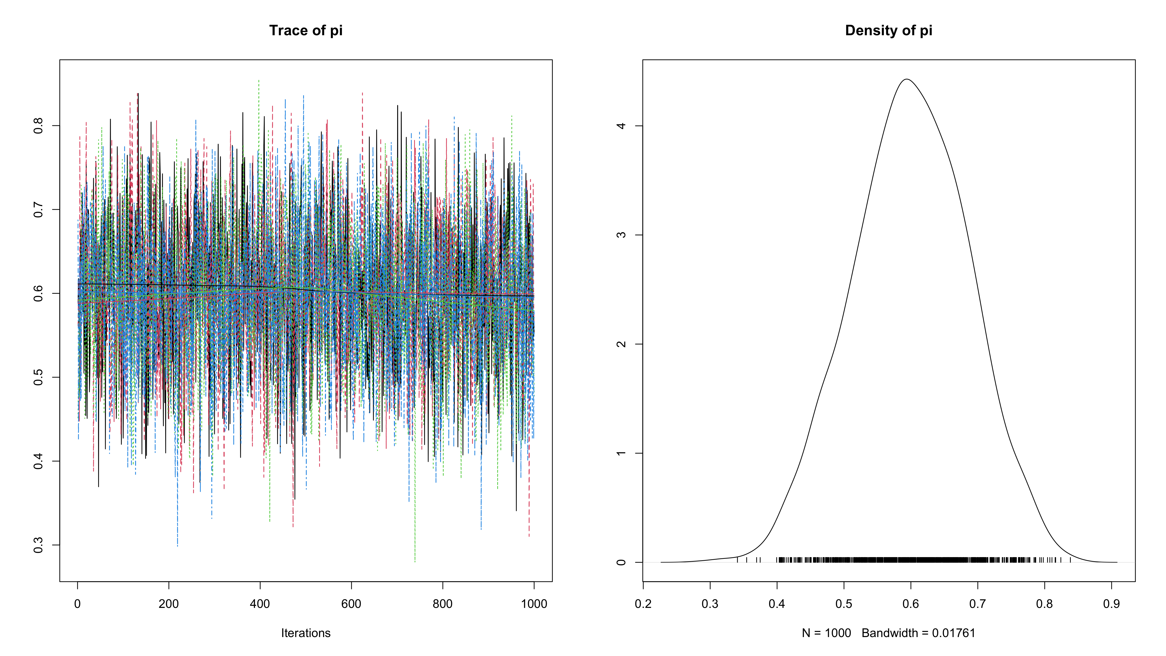
MCMC: diagnostics
The coda library has useful functions to check your MCMC output.
library(coda) # In all the code below, if you did not specify 'WAIC=TRUE' in the NIMBLE model, # then you can drop the '$samples' part; i.e. plot(parsPosterior) etc # check trace plot, empirical posterior distribution, potential scale reduction factor plot(parsPosterior$samples)

Slide 19
gelman.diag(parsPosterior$samples) ## Potential scale reduction factors: ## ## Point est. Upper C.I. ## pi 1 1.01 # posterior mean estimate summary(parsPosterior$samples)$statistics["Mean"] ## Mean ## 0.5989909 # posterior quantile based 95% credible interval summary(parsPosterior$samples)$quantiles[c("2.5%","97.5%")] ## 2.5% 97.5% ## 0.4240477 0.7669210

Slide 20
MCMC: diagnostics
You can get the same summaries in a single output by using the MCMCsummary() function from the MCMCvis package:
library(MCMCvis) MCMCsummary(parsPosterior$samples) ## mean sd 2.5% 50% 97.5% Rhat n.eff ## pi 0.5989909 0.08726481 0.4240477 0.5996183 0.766921 1 4000

Slide 21
MCMC: burn-in
MCMC algorithms usually take a few iterations (how many?) to move into the support region for a parameter.
We have seen that the Gibbs sampler (and Metropolis-Hastings more generally) is guaranteed to converge to the target distributions, but we said nothing about how long this would take.
For this reason, the initial iterations (the burn-in) are generally discarded as they are not samples from the target distribution.
How many to discard: depends on model, sampler, initial value…
A trace plot can help to check if a longer burn-in is required.

Slide 22
MCMC: mixing
It is important that the MCMC sampler explores the parameter space efficiently. We want to avoid iterations where the MCMC samples stay ‘flat’ in one region and also we want to avoid many steps in the same direction.
To avoid that a single chain gets stuck in one part of the parameter space, we should run multiple chains and check that they all explore similar regions of the parameter space.

Slide 23
MCMC: auto-correlations / thinning
We saw that MCMC chains are dependent sequences of samples – there will be autocorrelations between samples. Autocorrelations should drop off rapidly with increasing lag. If not, a chain can be thinned: e.g. keep only every 10th sample in the chain.
Generally thinning only makes sense for storage requirements: a long chain will average out autocorrelations and this results in higher-precision estimates than when the chain is thinned.
Autocorrelations can also be assessed by computing the effective sample size for each sampled parameter - this is the equivalent number of iterations if there were no autocorrelation. It indicates the information content of the MCMC process. Crucially, this is the sample size determining the convergence in the MCMC CLT.

Slide 24
MCMC: Diagnostics
To diagnose / check Bayesian models, fitted using MCMC, there are 2 main types of checks to make:
Posterior predictive checks – this is a general framework that Bayesian statistics provide to allow testing model assumptions. WAIC, which we specified to be computed in the earlier example, is the Widely Applicable Information Criterion (also known as Watanabe-Akaike Information Criterion) and is a metric of out-of-sample predictive accuracy.
MCMC diagnostics – this is to check that the MCMC algorithm seems to have converged (we can never be sure of this, but we can check for obvious non-convergence)

Slide 25
MCMC: Diagnostics
Here we focus (mostly) on the latter. There are many diagnostics that can be computed, but the main ones include:
Trace plots - should look like a hairy caterpillar if the posterior has converged to the stationary distribution.
Empirical posterior distributions of parameters in the model (and compare to prior) - should look sensible.
Potential scale reduction factor (Gelman-Rubin’s convergence diagnostic) - should be close to 1.
Effective sample size for the different sampled parameters; gives an indication of autocorrelations and indicates whether more iterations should be run to guarantee that the MCMC CLT holds.
WAIC or similar metrics - for comparing different models fitted to the same data.

Slide 26
MCMC: Alternatives to NIMBLE and alternatives to MCMC
Alternatives to NIMBLE
JAGS
Stan
Bayes-X
BUGS
…
Alternatives to MCMC
Integrated nested Laplace approximation (INLA)

Slide 27
EXAMPLE

Slide 28
Example: Bayesian linear regression model
Simulate the following data:
set.seed(1309) N<-50 x1<-rexp(N,rate=2) x2<-rnorm(N,mean=-2,sd=0.5) x3<-rpois(N,lambda=20) eps<-rnorm(N,mean=0,sd=0.75) y<-5+x1+0.1*x3+eps df<-data.frame(y=y,x1=x1,x2=x2,x3=x3)

Slide 29
Example: Bayesian linear regression model
Fit the following regression model using NIMBLE:
$$Y=β_{0}+β_{1}X_{1}+β_{2}X_{2}+β_{3}X_{3}+ϵ$$
where $ϵ∼N\left(0,σ^{2}\right)$

Slide 30
Example: Bayesian linear regression model
The NIMBLE model code:
modGLM<-nimbleCode( { for(i in 1:N){ y[i]~dnorm(yhat[i],tau) yhat[i]<-b0+b1*x1[i]+b2*x2[i]+b3*x3[i] } b0~dnorm(0,0.0001) b1~dnorm(0,0.0001) b2~dnorm(0,0.0001) b3~dnorm(0,0.0001) tau<-pow(sigma,-2) sigma~dgamma(0.1,0.1) } )

Slide 31
Example: Bayesian linear regression model
set.seed(123) # (optional) for reproducibility parsPosterior<-nimbleMCMC( code=modGLM, constants=list(N=nrow(df)), data=list(y=df$y,x1=df$x1,x2=df$x2,x3=df$x3), monitors=c("b0","b1","b2","b3","sigma"), nchains=4, niter=11000, nburnin=1000, samplesAsCodaMCMC=TRUE )

Slide 32
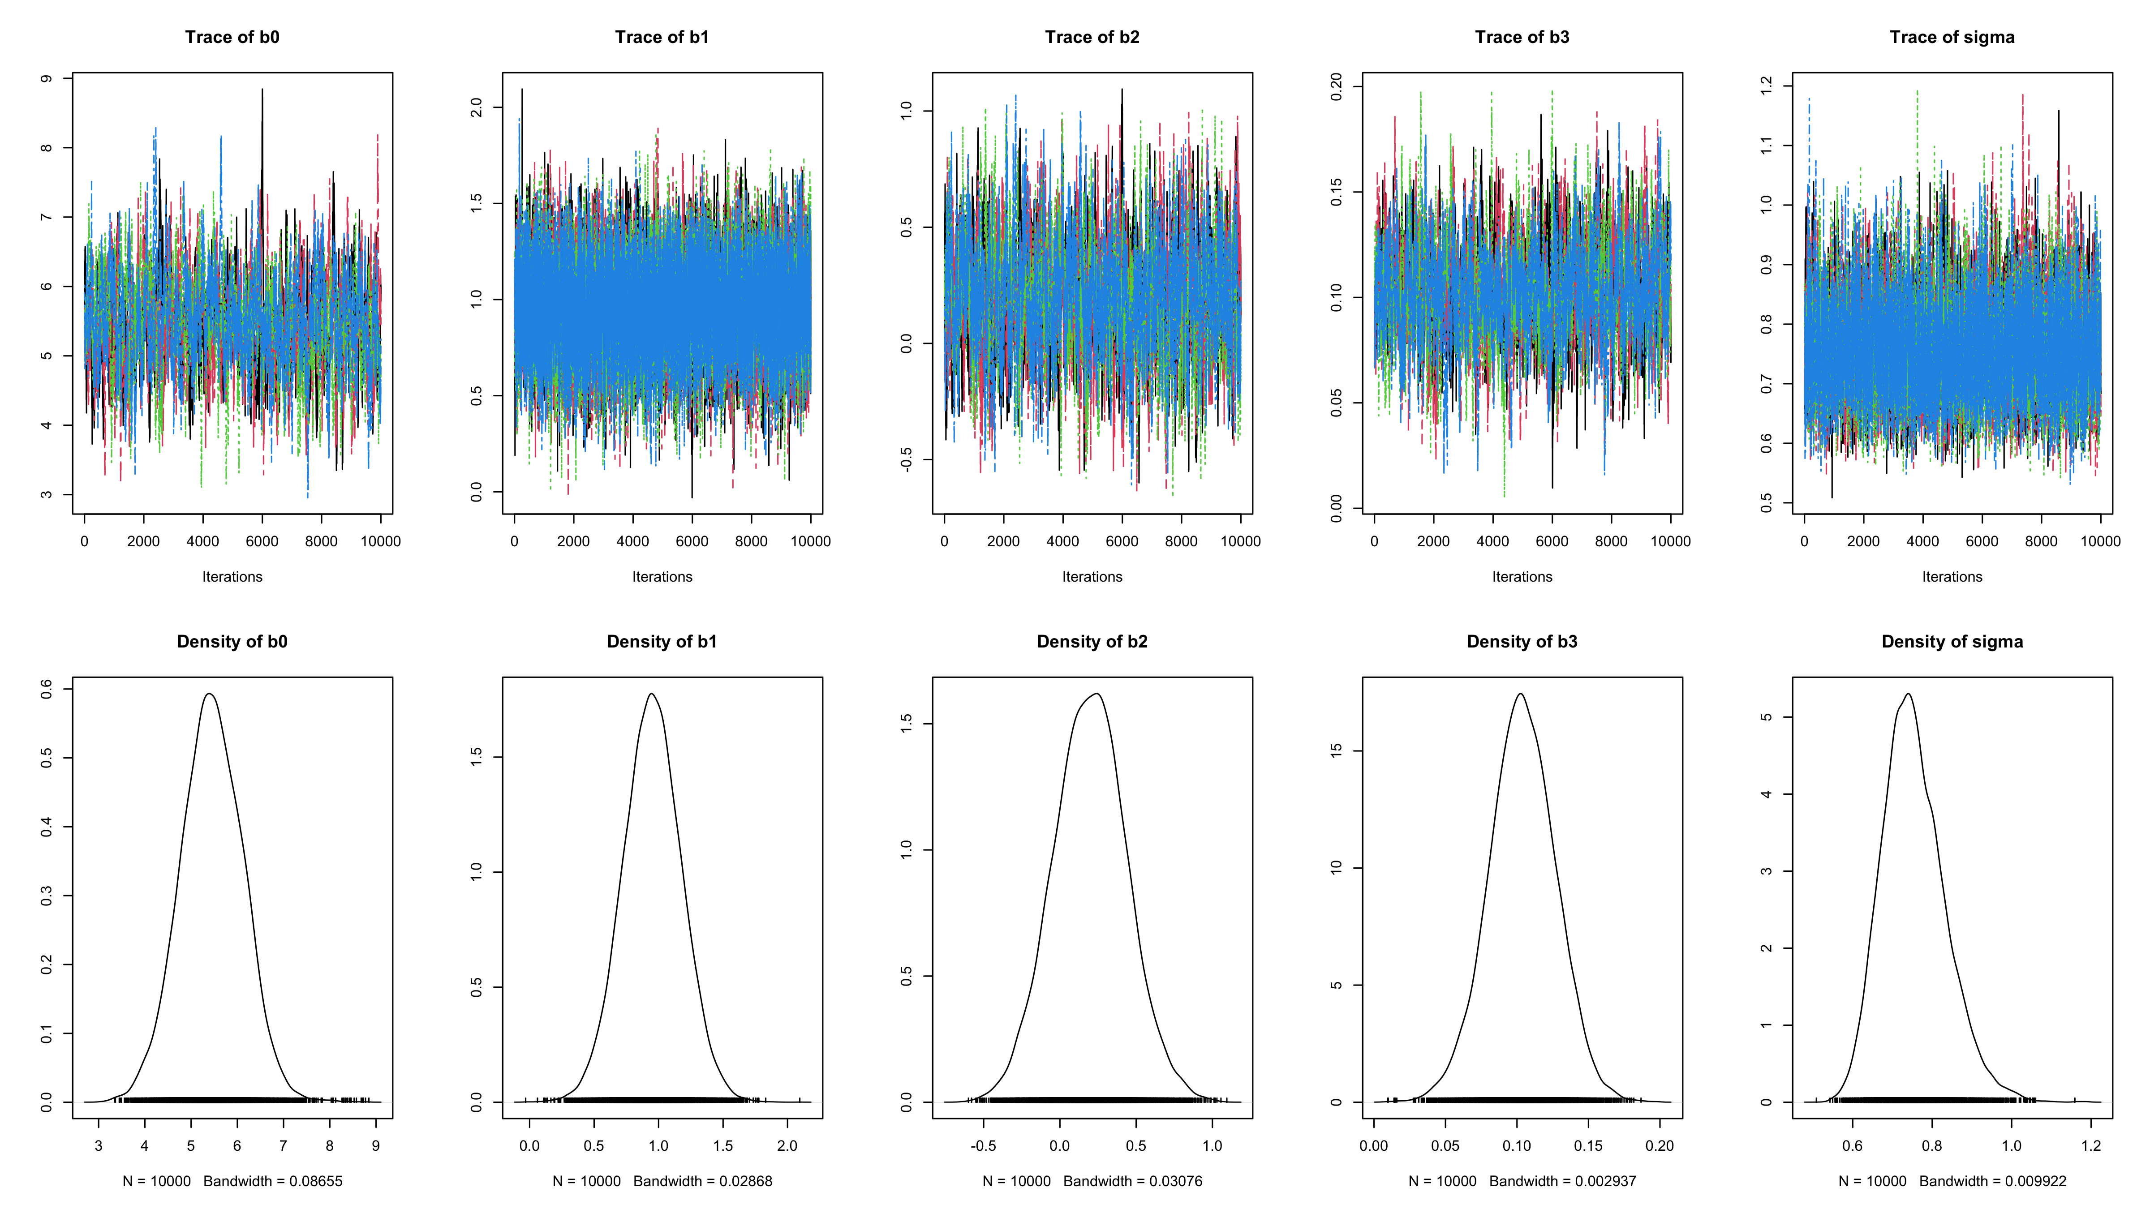
Example: Bayesian linear regression model
# check trace plot, empirical posterior distribution, potential scale reduction factor par(mfrow=c(2,5)) traceplot(parsPosterior) densplot(parsPosterior)

Slide 33
Example: Bayesian linear regression model
gelman.diag(parsPosterior)
Potential scale reduction factors: Point est. Upper C.I. b0 1.01 1.03 b1 1.00 1.00 b2 1.01 1.03 b3 1.00 1.01 sigma 1.00 1.00 Multivariate psrf 1.01

Slide 34
Example: Bayesian linear regression model
effectiveSize(parsPosterior)
b0 b1 b2 b3 sigma 559.5317 8599.6708 959.9527 901.1931 7513.6723

Slide 35
Example: Bayesian linear regression model
# posterior mean estimate summary(parsPosterior)$statistics[,"Mean"] ## b0 b1 b2 b3 sigma ## 5.4512950 0.9515548 0.1977067 0.1037935 0.7542105
# posterior quantile based 95% credible interval summary(parsPosterior)$quantiles[,c("2.5%","97.5%")]
2.5% 97.5% b0 4.1083535 6.7691517 b1 0.5023994 1.4010345 b2 -0.2759913 0.6807954 b3 0.0567035 0.1494124 sigma 0.6166397 0.9308013

Slide 36
Example: Bayesian linear regression model
The MCMCvis package provides a way to combine the parameter summaries with parameter-specific diagnostics:
MCMCsummary(parsPosterior)
mean sd 2.5% 50% 97.5% Rhat n.eff b0 5.4512950 0.67978300 4.1083535 5.4460185 6.7691517 1.01 560 b1 0.9515548 0.22849428 0.5023994 0.9510276 1.4010345 1.00 8600 b2 0.1977067 0.24195086 -0.2759913 0.1992354 0.6807954 1.01 960 b3 0.1037935 0.02350058 0.0567035 0.1037339 0.1494124 1.00 901 sigma 0.7542105 0.07993037 0.6166397 0.7470167 0.9308013 1.00 7514

Slide 37
Example: Bayesian linear regression model
Note that you can access all the individuals MCMC samples: parsPosterior is a list with 4 elements, 1 for each chain. Each element is simply a data frame with a column for every variable in the variable.names argument and the number of rows corresponds to n.iter/thin.
Use this to produce your own trace and histogram plots, compute various statistics of the parameters etc!
parsPosterior[[1]][1:10,] ## b0 b1 b2 b3 sigma ## [1,] 5.556194 0.7622882 0.006818571 0.08196353 0.7354032 ## [2,] 5.649104 0.8770670 0.056329434 0.07998191 0.8296416 ## [3,] 5.845487 0.5654574 0.014918379 0.08356947 0.8296416 ## [4,] 5.593312 1.0234984 0.182497236 0.09136098 0.6499593 ## [5,] 5.689520 1.1160244 0.201338173 0.08989110 0.6499593 ## [6,] 5.782594 0.8341678 0.139319639 0.08703490 0.6499593 ## [7,] 5.684924 1.0392181 0.086439855 0.08310488 0.8036415 ## [8,] 5.748479 0.5939684 0.074928230 0.08508148 0.7925079 ## [9,] 6.043985 0.5271855 0.228664027 0.08500948 0.7925079 ## [10,] 6.116821 0.8140915 0.414385238 0.09293210 0.7925079

Slide 38
Posterior predictive checks
More fundamental than the MCMC diagnostics, we also need to make sure the model itself is suitable for the data.
In general there can be 2 main reasons why a Bayesian model may not fit well:
Miss-specified prior: typically too strong a prior that conflicts with the observed data.
Miss-specified sampling model: some of the model assumptions are not met by the data.

Slide 39
Posterior predictive checks
The Bayesian paradigm, unlike the frequentist pardigm, provides a very general framework for checking model assumptions: posterior predictive checks.
The idea is simple, but powerful:
Simulate data from the posterior predictive distribution.
Compare this to the observed data.
Define a statistic that allows checking a model assumption.
Compute this for the observed data and then for a large number of simulated datasets.
Compute the proportion of times that the statistic estimates from the predicted data are as extreme as the one from the observed data – if this is too low it can indicate a violated assumption.

Slide 40
Posterior predictive checks - example 1
Suppose we assume
A binomial sampling model $Y_{i}∼\text{Bern}\left(π\right)$.
A beta prior $π∼\text{Beta}\left(200,50\right)$.
And let’s suppose we observe the following data
$0,1,0,0,0,0,0,0,1,1,0,0,0,0,0$ (i.e. n=15, k=3)
We have seen that the posterior distribution will be $\text{Beta}\left(200+3,50+15−3\right)=\text{Beta}\left(203,62\right)$

Slide 41
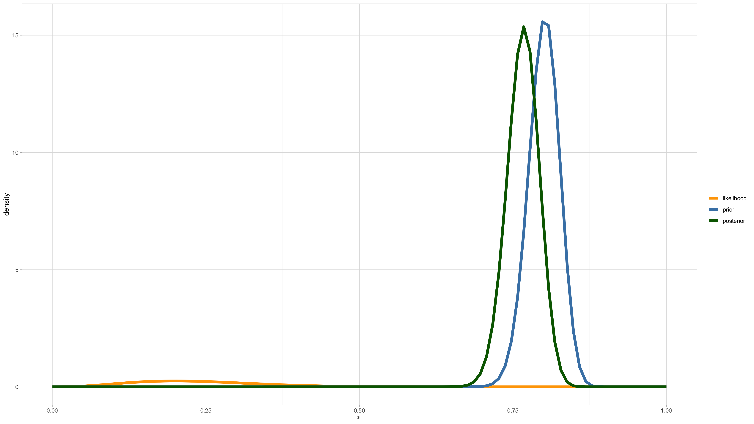
Posterior predictive checks - example 1

Slide 42
Posterior predictive checks - example 1
The posterior predictive distribution is Bernoulli with parameter $π_{post}$:
$$\begin{matrix}π_{post} & =p\left(\tilde{Y}=1|n=15,k=3\right)] \\ & =∫p\left(\tilde{Y}=1|π\right)p\left(π|n=15,k=3\right)dπ \\ & =∫π\frac{Γ\left(265\right)}{Γ\left(203\right)Γ\left(62\right)}π^{202}{\left(1−π\right)}^{61}dπ \\ & =\frac{Γ\left(265\right)}{Γ\left(203\right)Γ\left(62\right)}\frac{Γ\left(204\right)Γ\left(62\right)}{Γ\left(266\right)}=\frac{203}{265} \\ & =0.7660\end{matrix}$$

Slide 43
Posterior predictive checks - example 1
Writing $Y=\sum_{i=1}^{15}{Y_{i}}$ for $Y_{i}∼_{iid}Bern\left(π_{post}\right)$, then $Y∼Bin\left(n=15,π_{post}\right)$. Using this we can calculate $P\left(Y≤3|π_{post},n=15\right)=5.93⋅{10}^{−6}$.
So we are saying that based on the fact that we observed 3 successes among 15 trials, it is extremeley unlikely to observe 3 or fewer successes among 15 trials.
This clearly indicates a problem with our posterior model and it is due to a very strong prior favouring a high success rate and very little observed data with low success rate. In this case, the prior is 1) at loggerheads with the data and 2) too strong.

Slide 44
Posterior predictive checks - example 2
Suppose we want to estimate the probability of in-hospital death for A & E patients. Suppose we conduct a study where we recruit $n=30$ consecutive patients attending A & E and we record $Y_{i}=0$ if patient $i$ is alive at discharge and $Y_{i}=1$ if they died.
We can develop a Bayesian model by assuming:
A $\text{Beta}\left(1/2,1/2\right)$ prior.
A $\text{Bernoulli}\left(π\right)$ sampling model, i.e. $Y_{i}|π∼_{\text{iid}}\text{Bern}\left(π\right)$.

Slide 45
Posterior predictive checks - example 2
Now suppose we observe the following sequence of data where half-way through our study, there was a black-out at the hospital and a lot of life-saving equipment was not working:
$$0,0,0,1,0,0,0,0,0,0,0,0,0,0,0,1,1,1,1,1,1,1,1,1,0,1,1,1,1,1$$
In other words: all but 1 of the first 15 patients survived but all except 2 of the last 15 died.
This seems to be at odds with our assumption of independent data.
How can we test this independence assumption?

Slide 46
Posterior predictive checks - example 2
The data are consistent with $π=0.5$, but under the assumption of independence, we would expect a random pattern of 0’s and 1’s - in other word we would expect regular switches between 0 and 1 in the sequence of outcomes.
Let us define
$$T=\sum_{i=1}^{30−1}{I}\left(Y_{i}≠Y_{i+1}\right)$$
For the observed data: $T=5$ (5 switches).

Slide 47
Posterior predictive checks - example 2
We know that
$$\left\{\begin{matrix}π & ∼Beta\left(a,b\right) \\ y_{1},…,y_{n}|π & ∼Bern\left(π\right)\end{matrix}\right.$$
⇒Yn+1|y1,…,yn∼Bernπpost=a+i​yia+b+n
So here we have a=1/2,b=1/2,n=30,i​yi=15 and hence $π_{post}=\frac{15.5}{31}=0.5$.

Slide 48
Posterior predictive checks - example 2
So what we can do now, is repeatedly simulate data from the posterior predictive distribution (30 observations at a time, i.e. $\tilde{Y}∼Bin\left(n=30,π_{post}\right)$) and compute T each time, to compute how likely it would be to observe $T≤5$ under the posterior predictive distribution.
N<-1e5 t<-integer(N) for(i in 1:N){ y_ppc<-rbinom(n=30,size=1,prob=0.5) t[i]<-sum(y_ppc[1:(length(y_ppc)-1)]!=y_ppc[2:length(y_ppc)]) } sum(t<=5)/N
[1] 0.00039
So we find that the empirical probability of observing 5 or fewer switches is 3.9^{-4}. In other words, according to our model and the data we have observed, it is very unlikely that we would have observed the data we observed!
This is evidence that our model is not correct and in this case it is due to a wrong assumption of independence.

Slide 49
[end of STA623 Bayesian Data analysis Session 5]

